Slide 1
Term 4 Week 2 Lesson 1
What affects rate

Slide 2
Collision theory states that the rates of reaction depends on the number of successful collisions between reactant particles in a given time.
Number of successful collisions depends on the:
Total number of collisions
Percentage of collisions that are successful
Any factor which increases either of the above factors will lead to an increase in rate of reaction.

Slide 3
Nature of reactants
This means what are the reactants and what needs to happen for them to form the products.
If the bonds of the reactants are weak or few then they need a small amount of energy to break. So the activation energy will be low, and a large number of particles will have enough energy for a successful collision.
The size of the particles may also affect the rate of the reaction. If the particles are larger, greater chance that they will collide.

Slide 4
Concentration and pressure
Concentration refers to the number of particles in a given volume.
The pressure of a gas is determined by the concentration of gaseous particles.
Greater the concentration or pressure, the greater the number of particles and therefore greater number of collisions. Even though the percentage of collisions that will be successful will remain the same, there will be more successful collisions in total because there are more collisions. Therefore, as the concentration or pressure, of the reactants increases, the reaction rate increases.

Slide 5
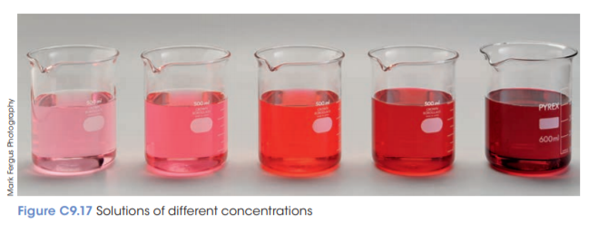

Slide 6
Changing volume may also change the concentration. Diluting the solution using water can decrease the concentration whereas, evaporating the some of the water from a solution can decrease the volume and increase

Slide 7
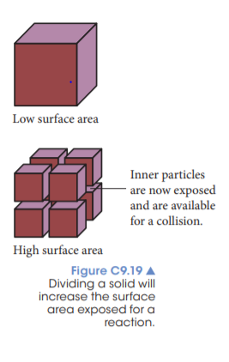
Surface area
If a solid is divided or crushed then the inner particles become exposed and, although the amount of reactant remains the same, the total surface area has increased. So more of the solid is available for collisions and is able to react. Therefore, there are more collisions and thus the rate of reaction will increase.
E.g. we cut potatoes up into small pieces to cook them quickly

Slide 8
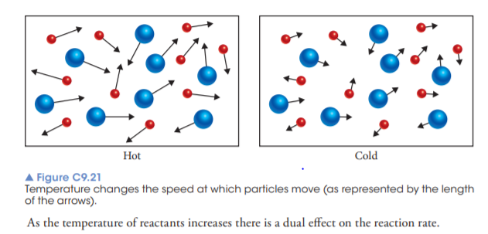
Temperature
The temperature of a substance is a measure of the average kinetic energy of the particles. As the temperature increases, the average kinetic energy also increases and hence the average speed of the particles also increases.

Slide 9
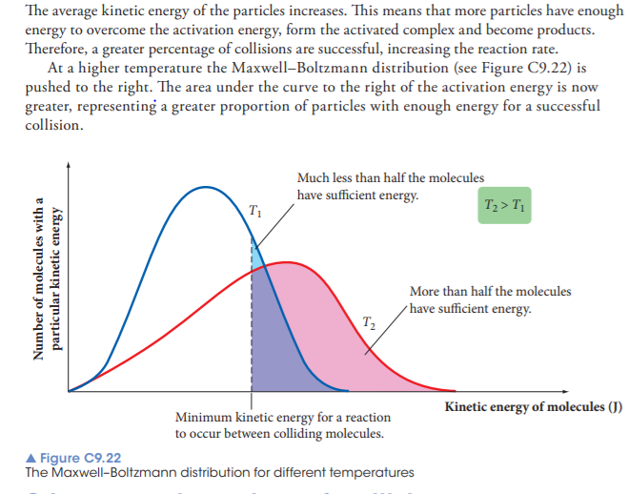
Increased percentage of collisions that are successful
The av

Slide 10
Catalysts
A catalyst is something that can affect the rate of a reaction. Positive catalysts increase the rate of the reaction and negative catalysts decrease the rate of the reaction.
All positive catalysts provide an alternative pathway for the reaction, which is easier and therefore has a lower activation energy.
A lower activation energy means that more molecules have enough energy for successful collisions. Therefore there are more successful collisions and therefore a faster rate of reaction.

Slide 11
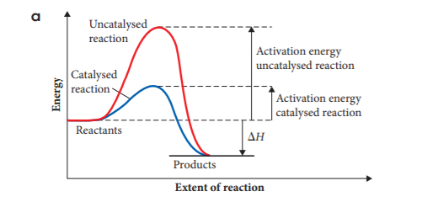

Slide 12
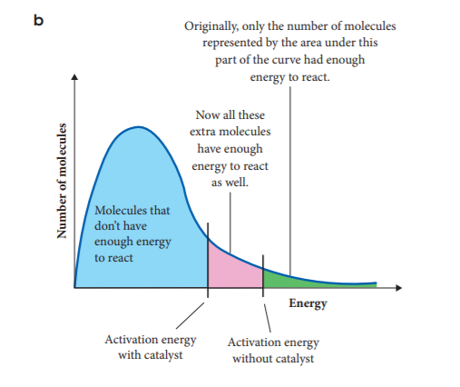

Slide 13
One type of catalyst that is being used more commonly is metal nanoparticles. Metal nanoparticles have an advantage over other metal catalysts due to their large surface area. This means that a large amount of the reactants can access the catalyst and therefore have a greater impact on the reaction rate.

Slide 14
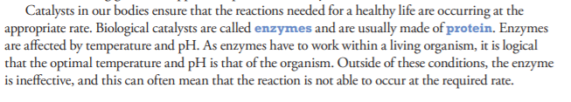

Slide 15
